Slide 1
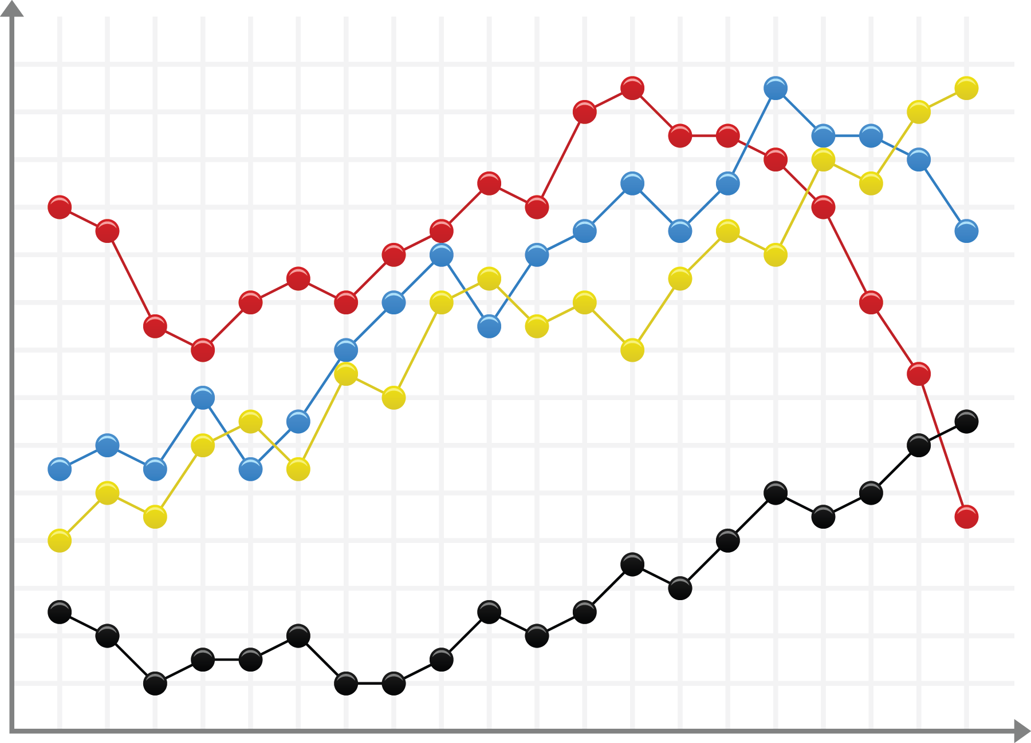
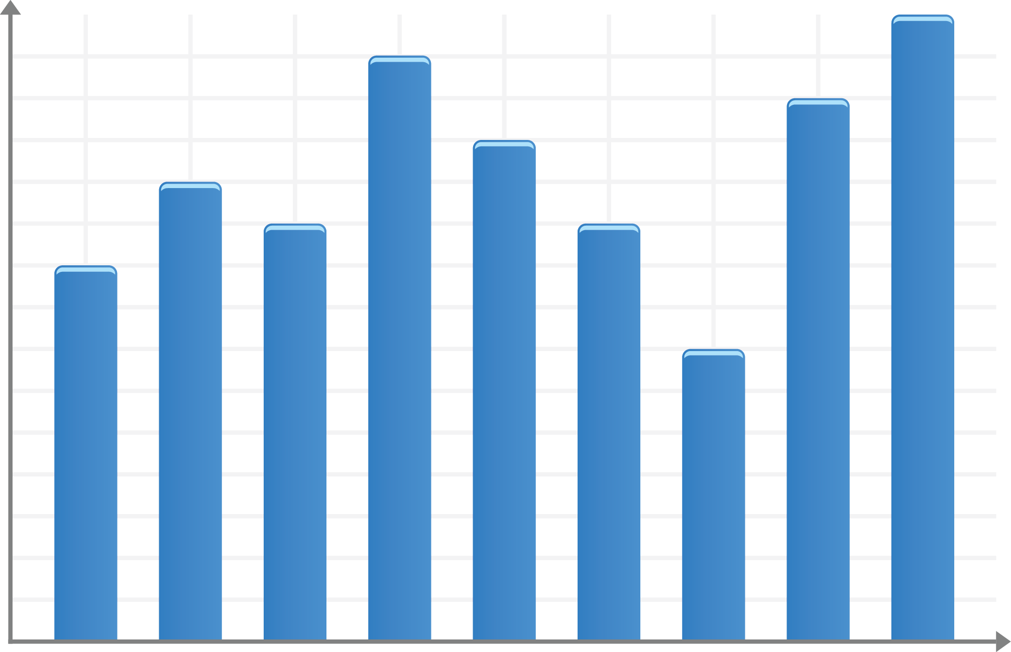
Start Here! Make it Interesting. Catchy.
Ideally, you want viewers to see your message here first.
Researcher Name, PhD, Investigator Last Name, MD, Another Person, MS
YOUR UNIVERSITY LOGO HERE
BACKGROUND
RESULTS
Provide a very brief description of your research. Just a few key lines or bullets. Unless the poster session/meeting requires it, you should not put your abstract on the poster.
OBJECTIVES
Graphs/Tables/Charts
Graphs/Tables/Charts
Your poster is an opportunity to engage viewers in a discussion of your work
It is not a mini-paper. Be brief.
Use short sentences or bullets to convey the objectives of your work.
Graphs, tables and charts should be clear
Include only key data that supports your message
METHODS
Again, the fewer words you can use, the better. Only include the most relevant information about your research.
You can always have a poster handout that includes your abstract, methods, resources and whatever other information you want interested viewers to have.
Graphs, tables and charts should be clear
CONCLUSIONS
Here's the place for your message(s). You should have one or two main messages.
What do you want to tell the viewer about your research and why it is important? Make sure that your findings are simply and clearly stated.
This will focus the viewer's attention on what it is you are trying to communicate about your research.
YOUR FUNDING PARTNER LOGOS HERE
Photos need to be of high enough quality that they print well in the large poster format. Especially important, make sure that they actually support your message. Photos for the sake of photos only detract from your message.
Use this area to write an acknowledgement. Thank all organizations that provided support for your project.
© Copyright 2012. Info and Other Footer Info to Go Down Here.

